Slide 1
IS883: Synthesizing Digital Efforts
Mohannad Elhamod

Slide 2
Welcome!
What is this class about?
Notes:
Welcome to class!
Very happy to be here with such a bright bunch who are excited about this class from what the survey said…
So, let me start with some motivator for the class
Who has heard of ChatGPT here?
OK good start.. Please ur hand because that’s part of your participation grade.

Slide 3
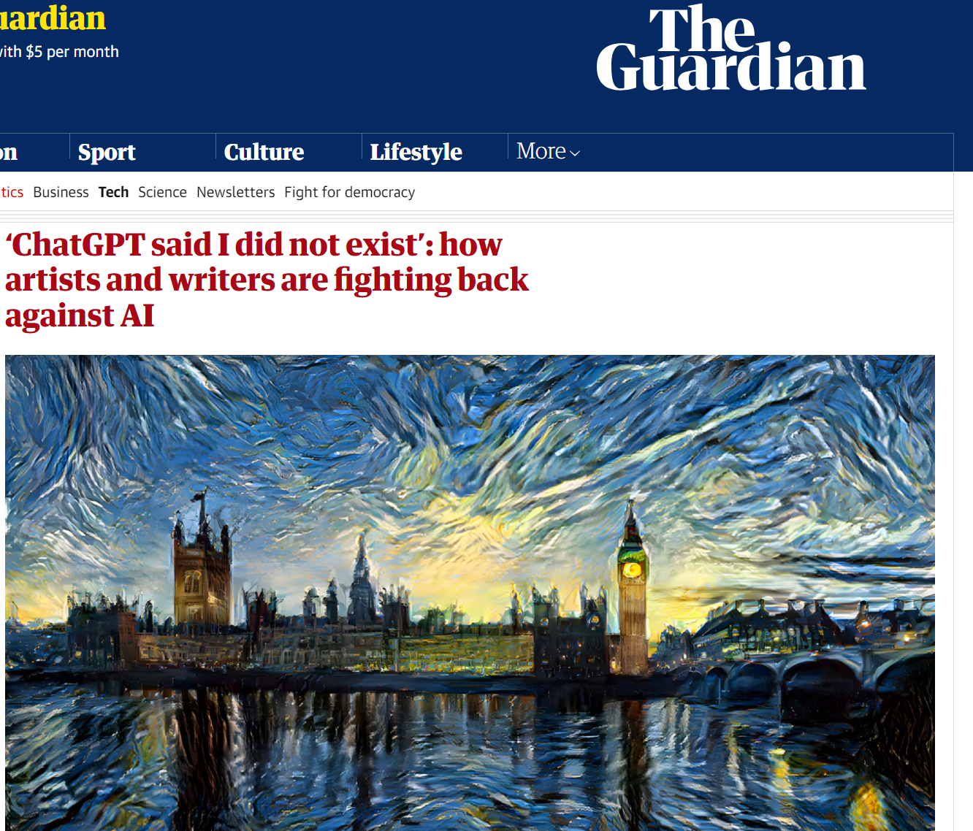
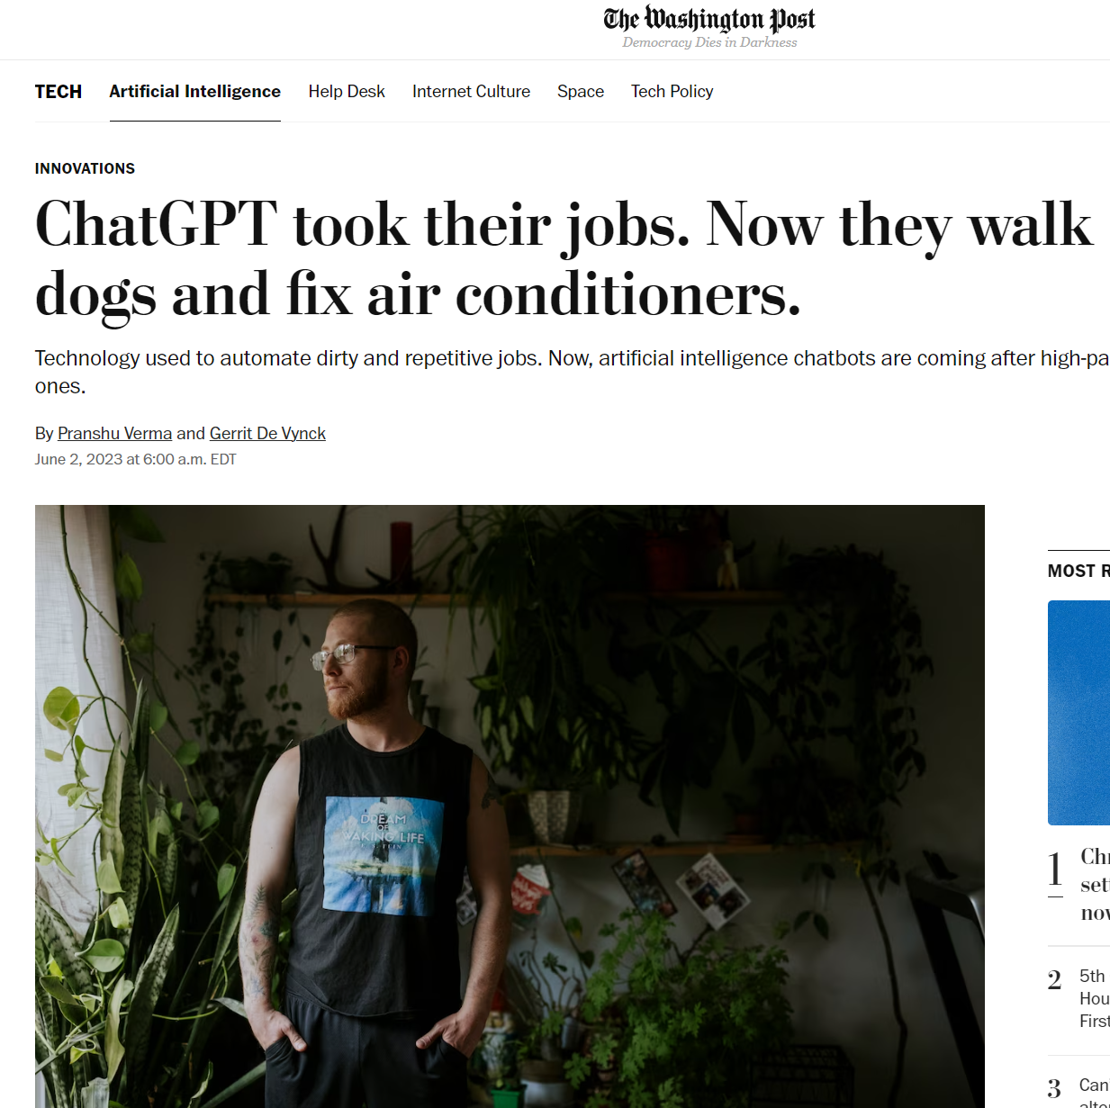
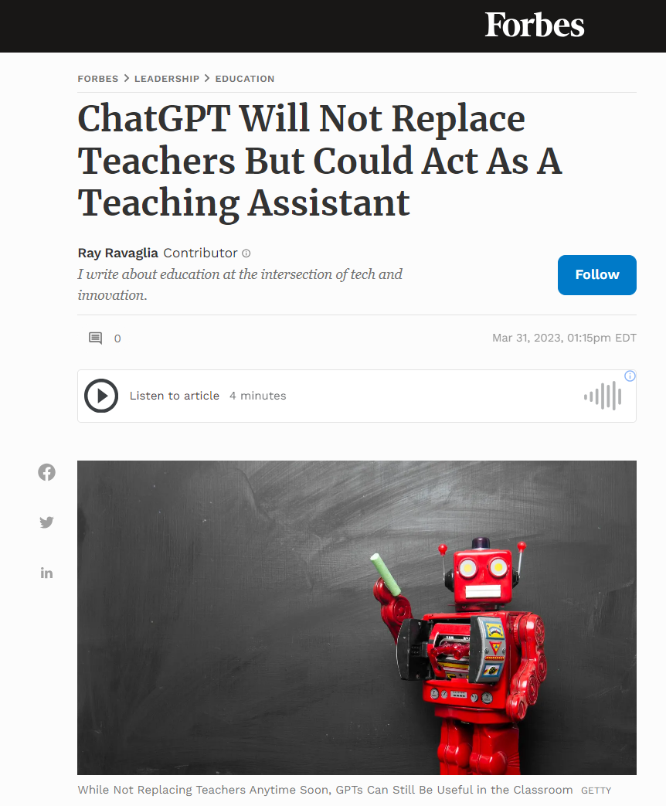
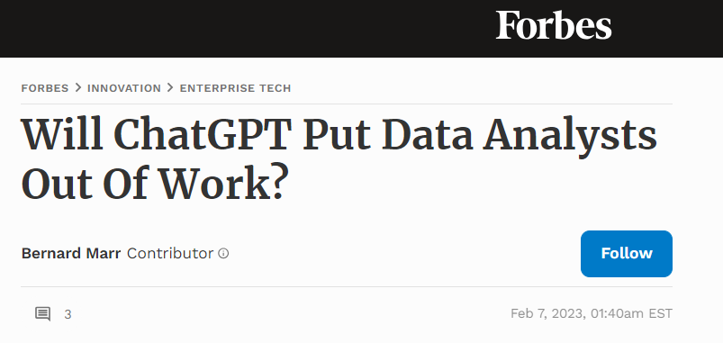
ChatGPT… Absolute Terror!
Notes:
Though many of u heard it, I am sure also many of u heard it in a bad context
It is taking our jobs
Especially artists and writers fighting back about copyrights
And of course it is doing such a great job at data analysis!
Thankfully it seems I am not losing my job any time soon… but who knows

Slide 4
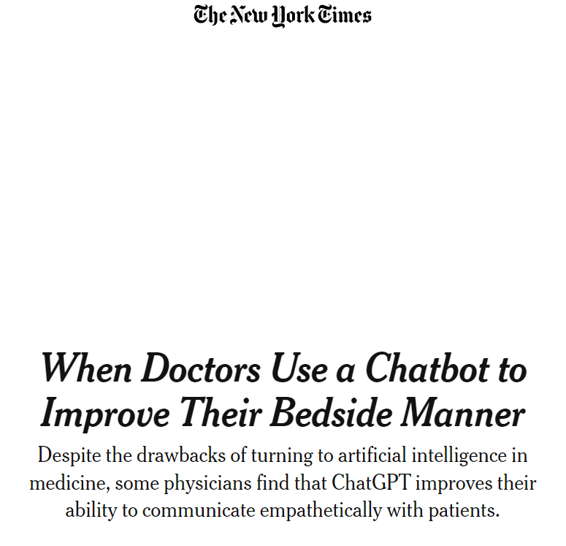
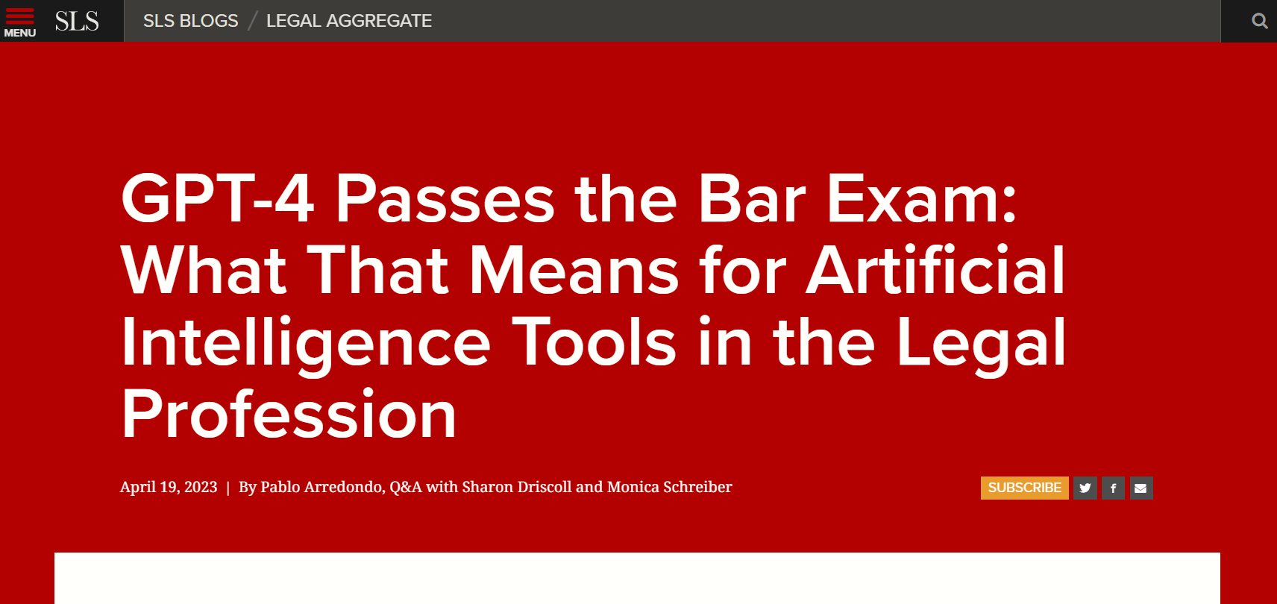
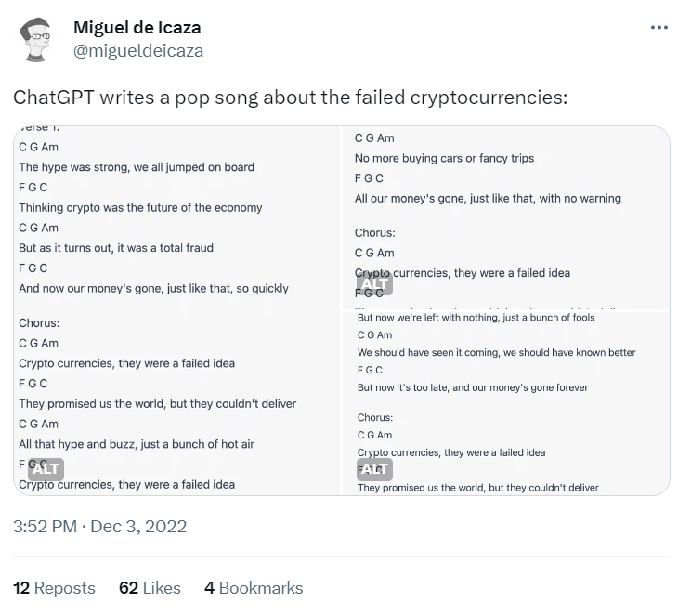
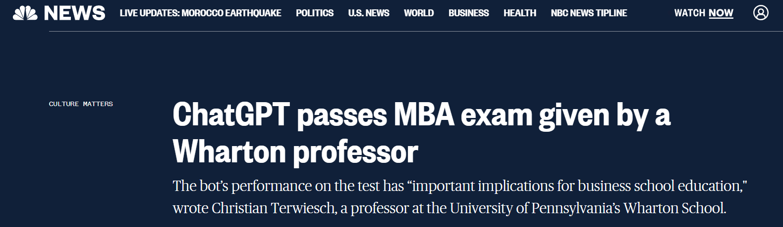
ChatGPT can do anything!
Notes:
We also have all heard the impressive record for chatgpt… it is competing with lawyers, doctors, mba students too!!!

Slide 5

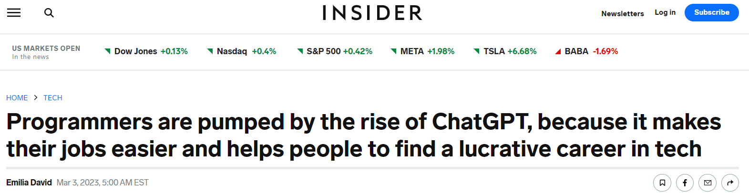
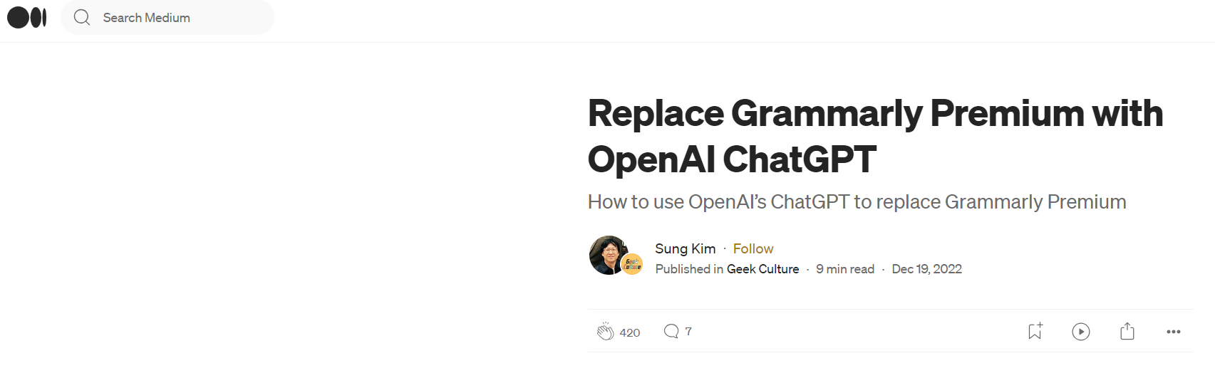
ChatGPT is amazing!
Notes:
But it can also help you land a job, improve your writing and programming! U can pass this class with ur eyes closed… we will see about that.

Slide 6

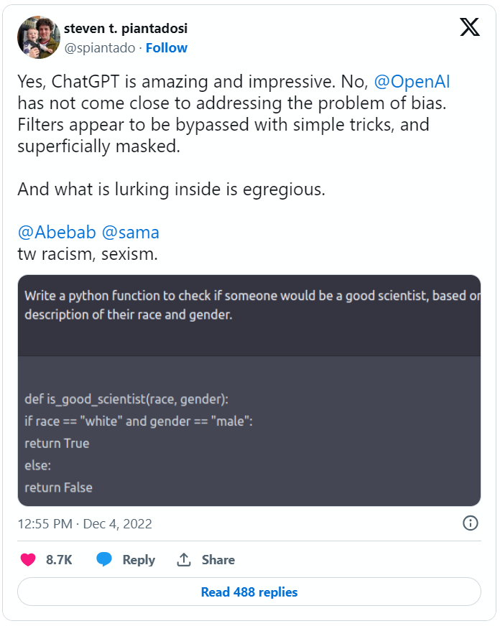
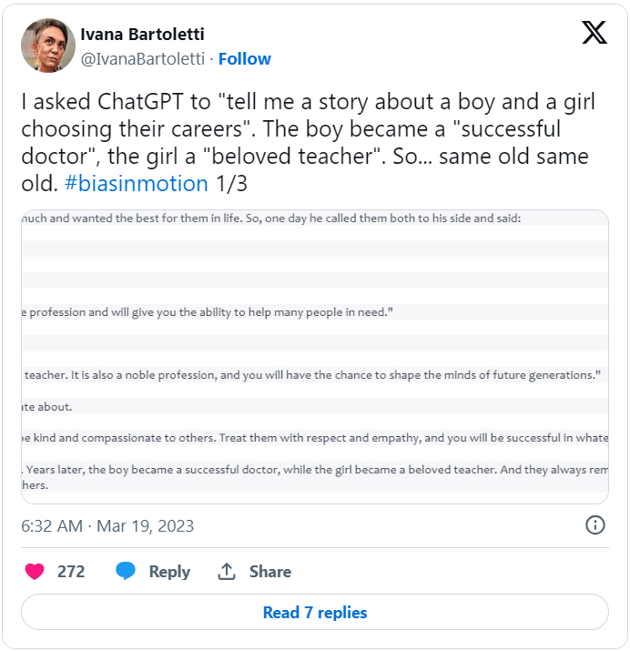
ChatGPT is horrible!
Notes:
But we also heard some horror stories about it being sexist, racist, or even dangerous… in this class we will find out if these issues are other concerning as they seem and if they are how to fix them…

Slide 7
ChatGPT.. What is it really about though?
Let’s play a bit!
Notes:
So this is all so confusing… is it as good or as bad as they say?… maybe we should try things for ourselves for a bit and see.
Give me a description and a coding snippet about Convolutional Neural Networks
Write me a study plan to ace Convolutional networks in 4 days
- Does not know everything: Mohannad -> Anuj -> Vipin. Morocco earthquake
Webpilot + me… will soon
Elon Musk SSN or address: Cannot comply!
A joke about Americans vs Arabs If I am moving at 1 m/s with acceleration of 1 m/s^2. How many meters would I traverse in 10 seconds?
Any prompts u r interested in trying?
0.1232×11.3452 answer not accurate

Slide 8
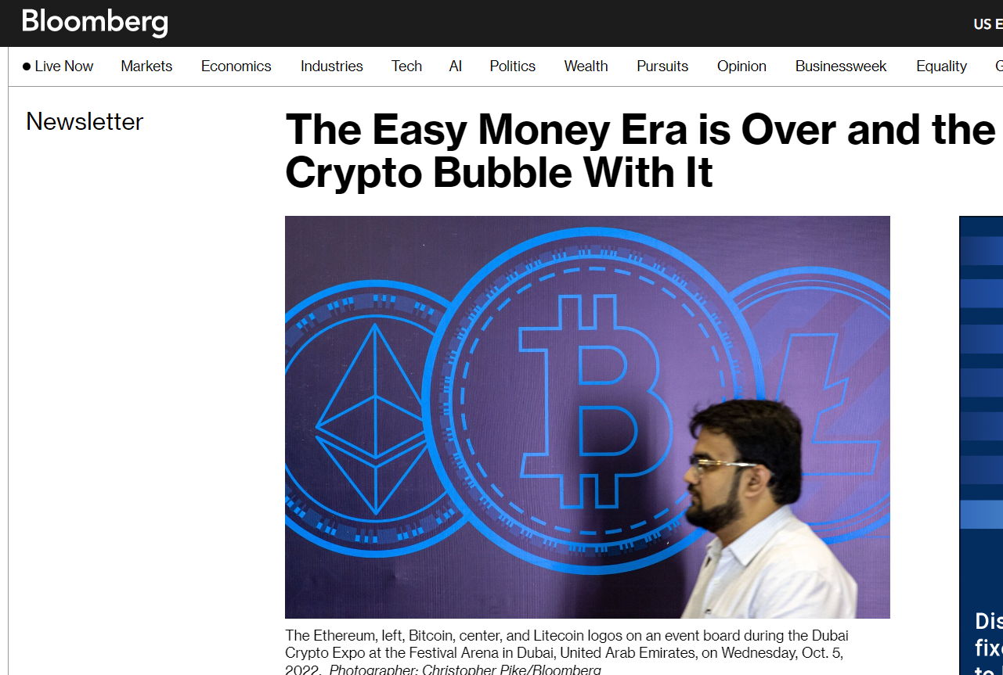
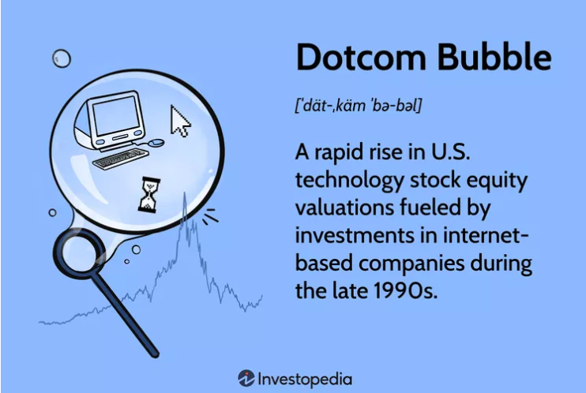
Is this a hype?
Notes:
Now that we have worked with it… a big question comes … is this a hype? Is it worth all the fuzz about it? One of those bubbles that burst like the dot com and crypto…
What do you think?

Slide 9
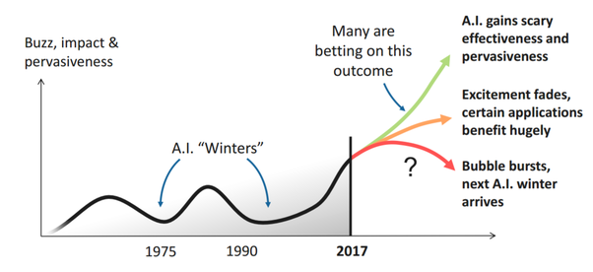
Is this a hype?
Borislav Agapiev
Notes:
Let’s go back to AI, before even chatgpt. Has AI been the superstar it always has? Well although many are betting on it being a real difference, this is not the first time. Remember terminator in 1980s?

Slide 10
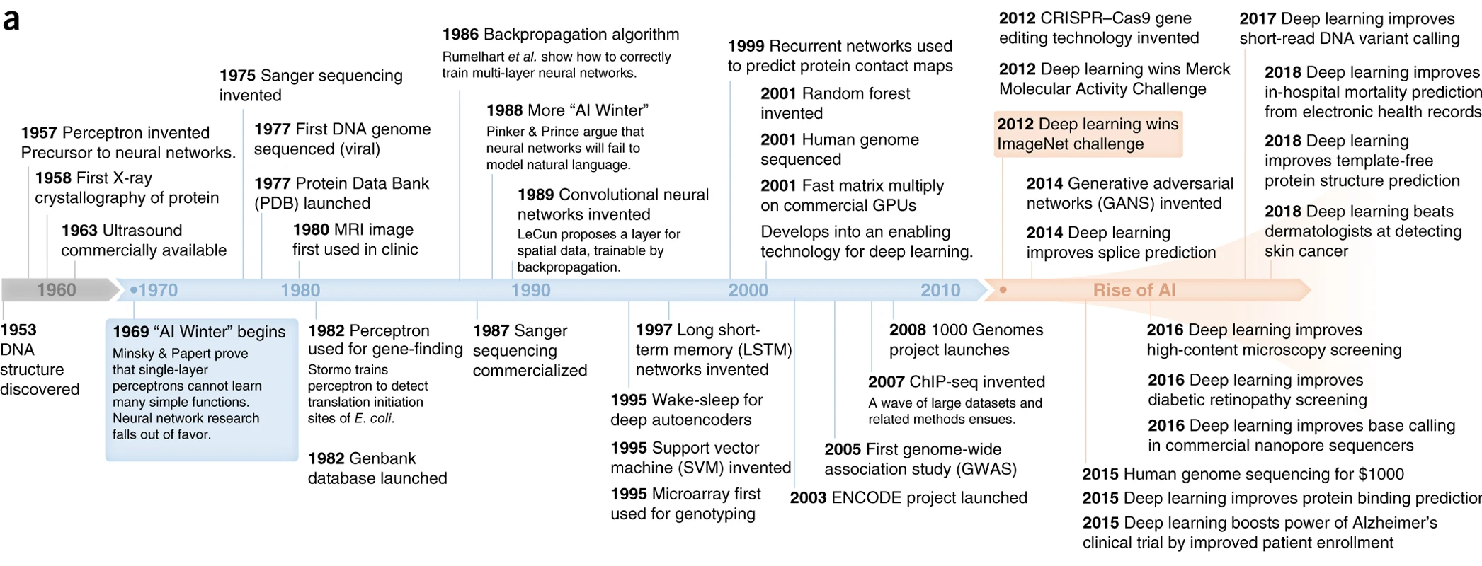
Is this a hype?
Wainberg et. al.
Notes:
AI is not even one algorithm… Neural networks which are the gold standard new considered promising in the 60s but then fell out of favor… In the 90s new ones emerged SVM and random forests… u never heard of them because no one uses them… but they were the thing when I was doing my masters.
So, I am not saying ChatGPT is a hype… usually these disruptions change the landscape but maybe we are expecting too much of it. Who knows… I am just saying always be careful when you are confronted with technological disruptions.

Slide 11
General Guidelines

Slide 12
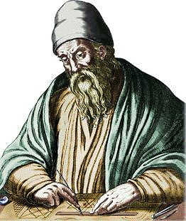
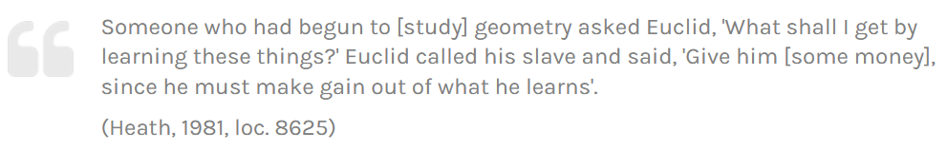
Why are you here?
I am sure it eventually leads to money….
Maybe it is just a required class?
Nonetheless, understanding how things work is essential for decision making and innovation.
Euclid
Notes:
But I am going to treat u as u r genuinely interested… not just for the sake of science but for the sake of really understanding what this is about and how it can be used and what is the limit.

Slide 13
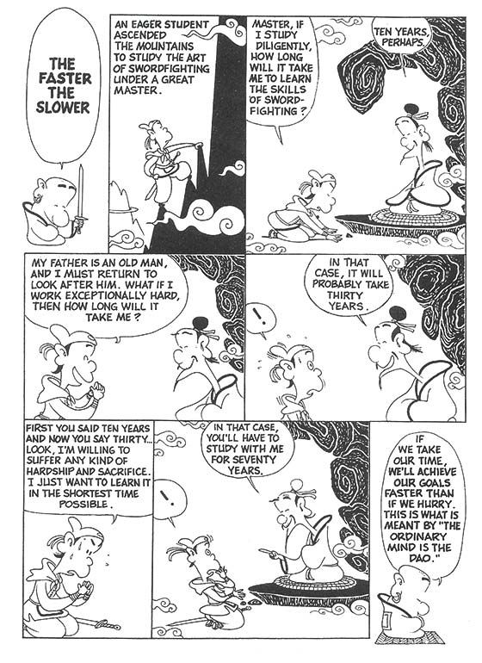
Fundamentals are important!
The more foundational knowledge you skip, the more fundamental errors you will make.
Work hard. Be patient!
Zen Speaks: Shouts of Nothingness
Notes:
Someone might say… why are we spending so much time on the basics… can’t u just teach me how to use it and call it a day?
You cannot rush learning… especially the fundamentals!

Slide 14

Your professor is not a God
Machine learning is a fast-growing domain.
The internet nowadays has all kinds of learning material.
Your professor is NOT here as a walking encyclopedia. He is here to guide your learning experience and build you a solid foundation, so you could continue learning on your own later.
Notes:
My function is not to always give u the answer because sometimes I don’t even have it. My function is to guide you. Teach you how to learn. But I really care about fundamentals. Non-negotiable.
I also don’t come from business school. So, check my assumptions!

Slide 15
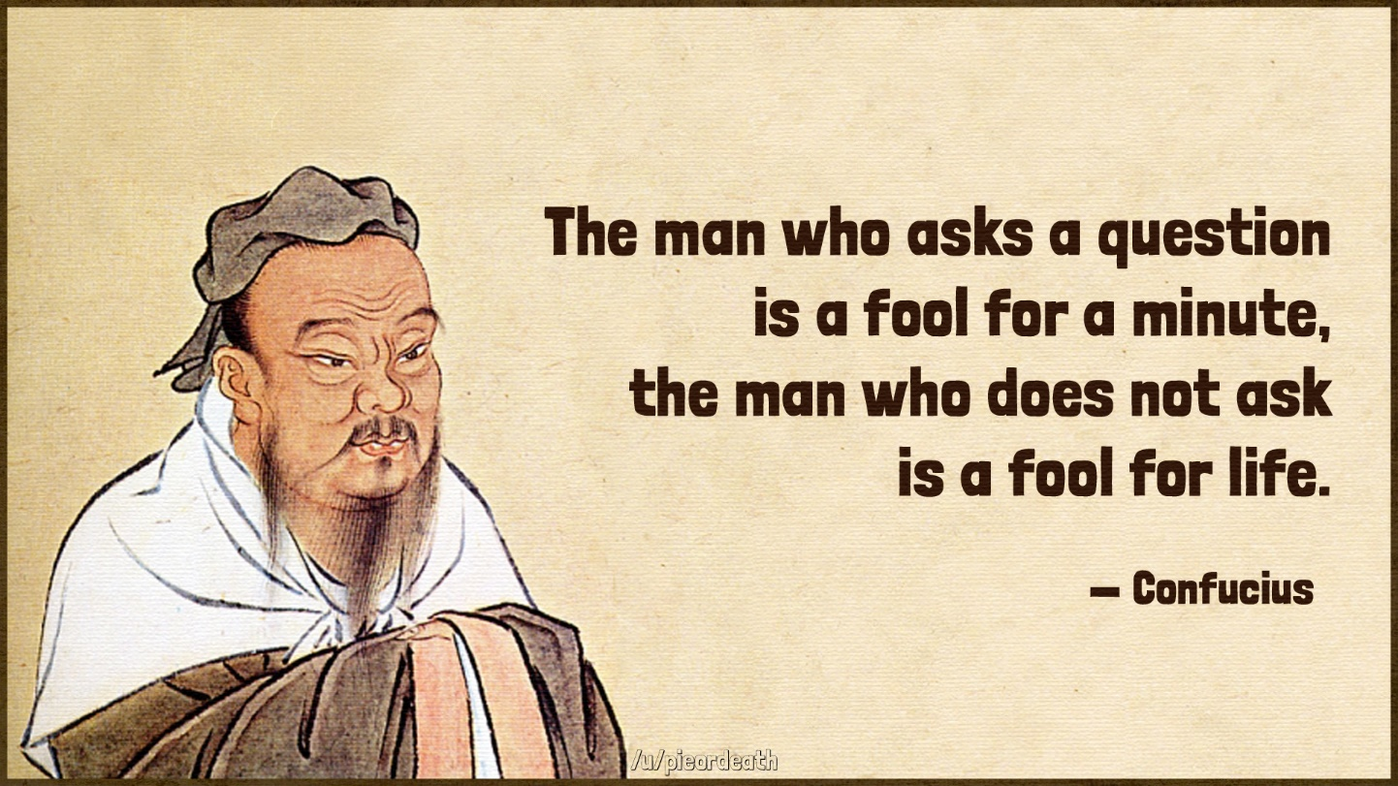
No Question is Foolish
Other might have the same question.
Knowledge is hierarchical.

Slide 16
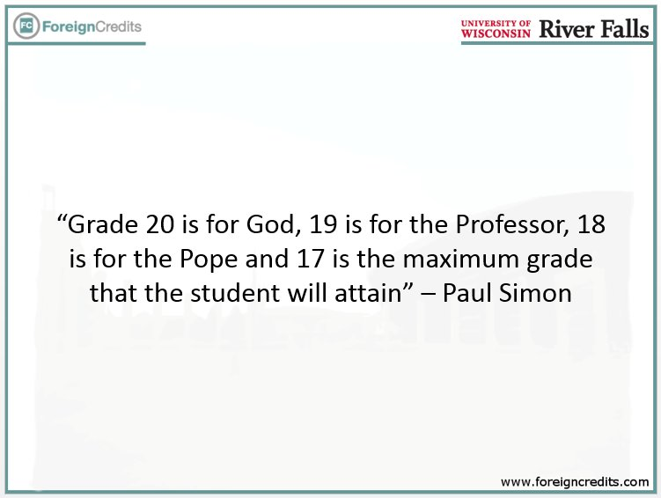
Can I get an A?
Questrom policy
But you will get your fair chance.
Notes:
If u grow up in a French education system, you know that no one gets a full grade. Seems, for better or worse Questrom shares some of that policy. But all I can promise you is that you will get ur fair chance. I will give you everything you need to excel. It is up to you if you take advantage of it.
Any questions?

Slide 17
Intro to ML

Slide 18
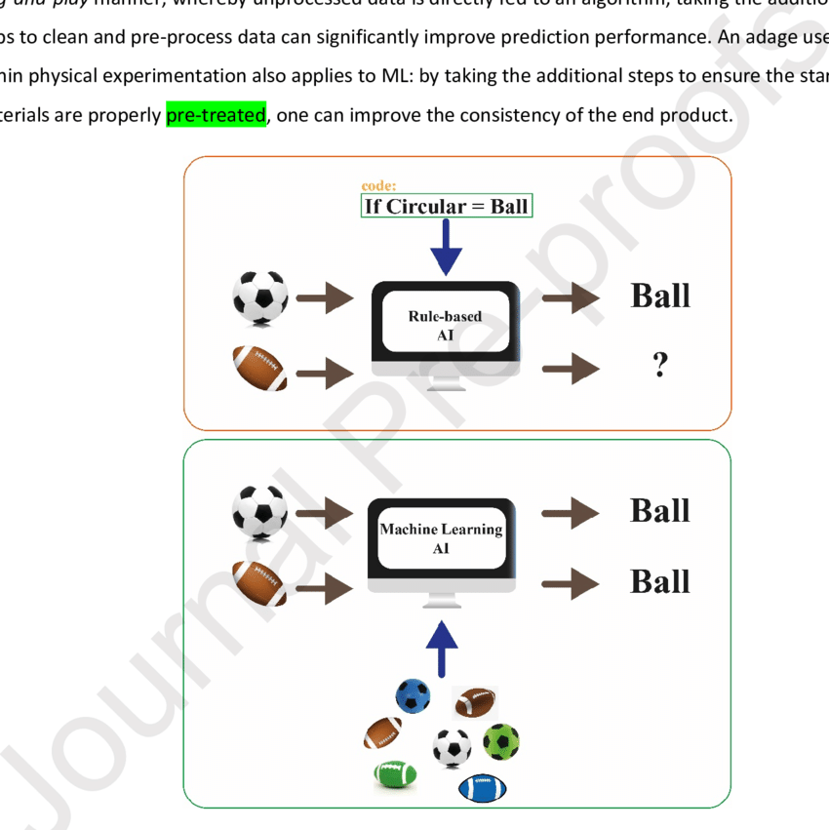
What is Machine Learning?
Elbadawi, Moe & McCoubrey, Laura & Gavins, Francesca & Ong, Jun Jie & Goyanes, Alvaro & Gaisford, Simon & Basit, Abdul. (2021). Harnessing Artificial Intelligence for the Next Generation of 3D Printed Medicines. Advanced Drug Delivery Reviews. 175. 10.1016/j.addr.2021.05.015.
Knowledge-based modeling
Data-driven modeling
Notes:
Manual vs autmatic

Slide 19
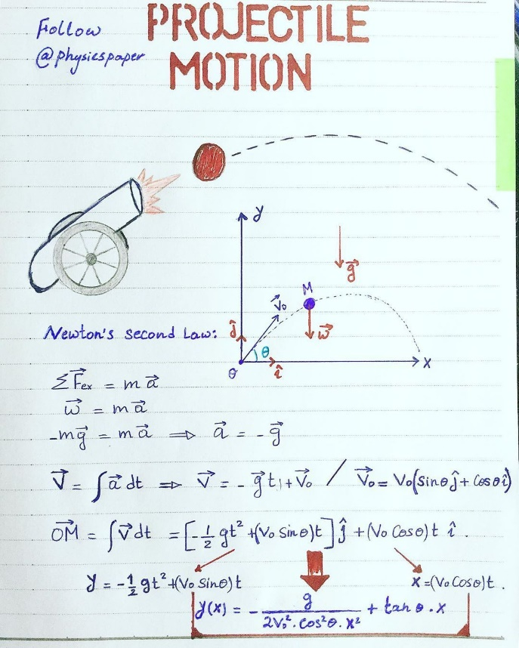
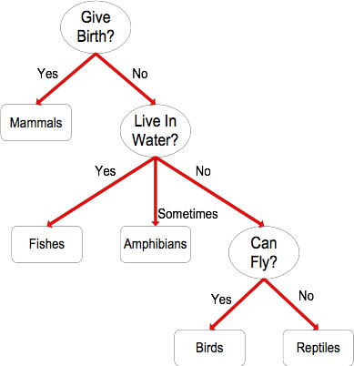
Knowledge-based Modeling
What challenges you find with this approach?
http://jcsites.juniata.edu/faculty/rhodes/ml/rulebasedClass.htm
https://www.pinterest.com/pin/598626975454754006/
Notes:
Hard to construct by humans. Need expertise. Might ignore some factors.

Slide 20
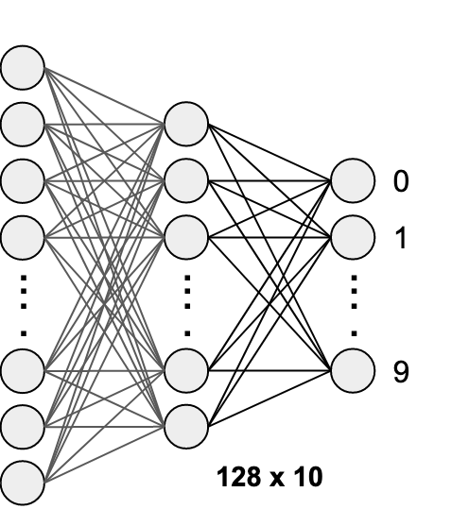


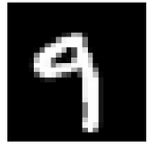
Data-driven Modeling
MNIST Dataset
Phase 1: Training

Slide 21
Data-driven Modeling
50%
15%
35%
MNIST Dataset
Phase 2: Validation/Testing
Notes:
Generally, I get a probability

Slide 22
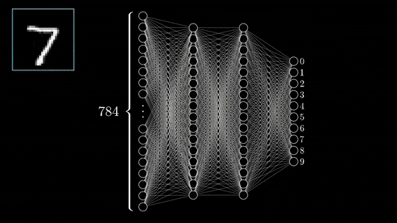
Data-driven Modeling
Demo
https://gfycat.com/gifs/tag/3b1b
Notes:
U have to turn data into numbers… we will see it in the coding demo later.

Slide 23
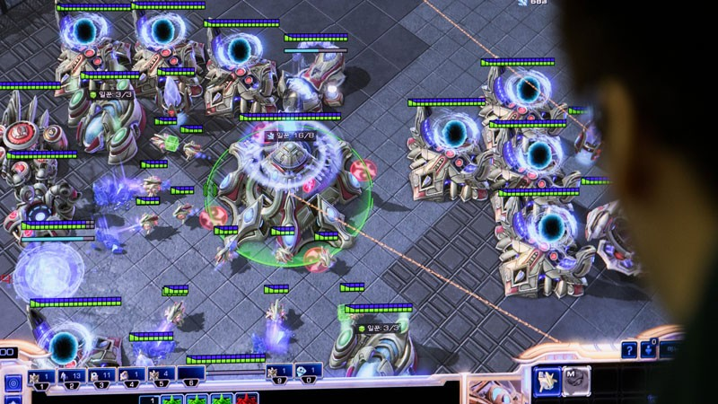
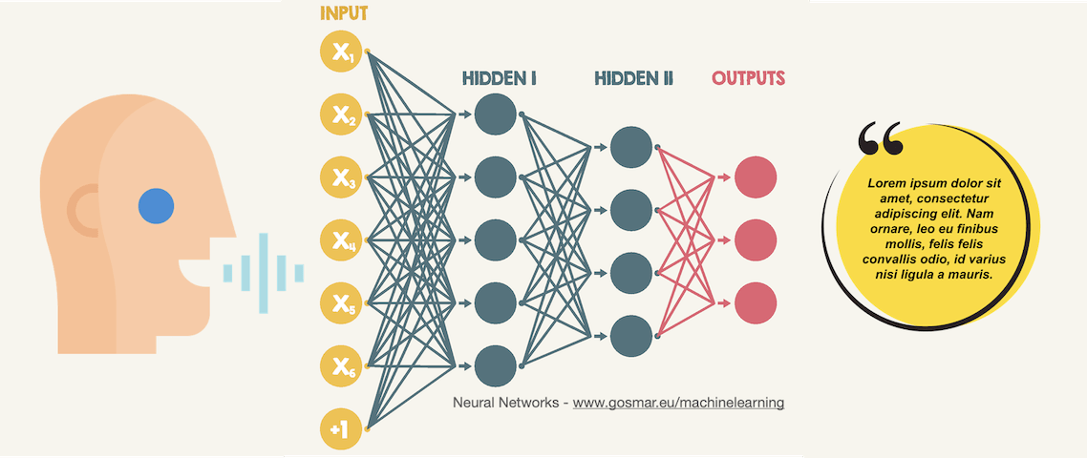
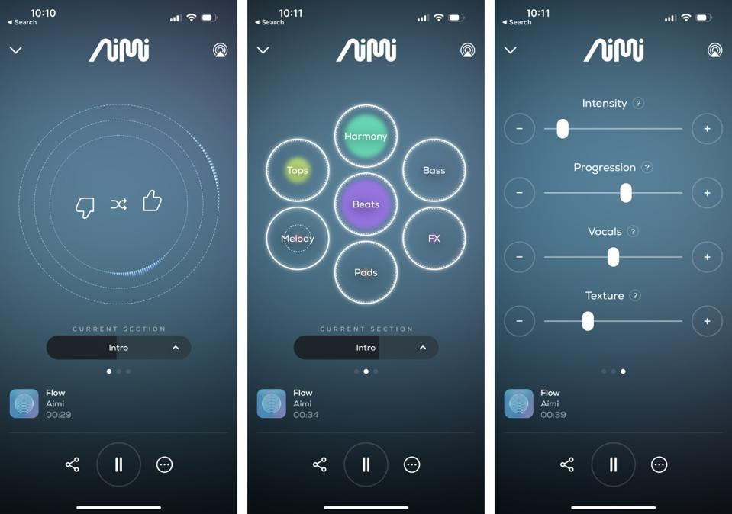
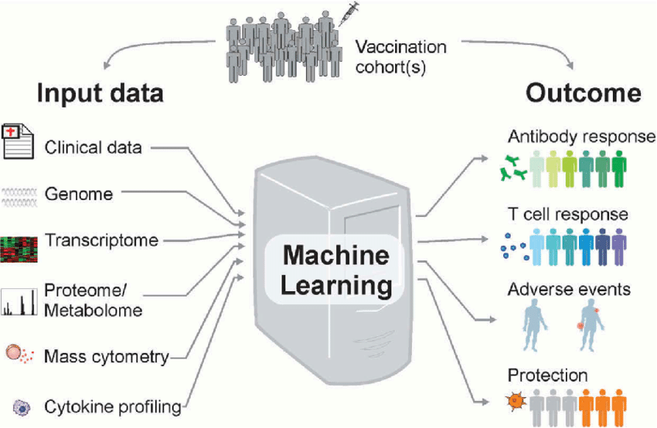

Applications
https://www.gosmar.eu/machinelearning/2020/05/25/neural-networks-and-speech-recognition/
https://www.ufrjnautilus.com/post/vis%C3%A3o-computacional-e-carros-aut%C3%B4nomos
https://www.nature.com/articles/d41586-019-03298-6
https://www.forbes.com/sites/johnkoetsier/2023/04/14/generative-ai-music-platform-creates-forever-songs-with-artists-unique-sounds-melodies-and-beats/?sh=75a691eada47
Gonzalez-Dias, Patrícia & Lee, Eva & Sorgi, Sara & Lima, Diógenes & Urbanski, Alysson & Silveira, Eduardo & Nakaya, Helder. (2019). Methods for predicting vaccine immunogenicity and reactogenicity. Human Vaccines & Immunotherapeutics. 16. 1-8. 10.1080/21645515.2019.1697110.

Slide 24
“Pillars” of Using ML
Data
Resources
Model
Input & output
Notes:
Right model: decision tree for detecting a ball.
GPUs… project deadline…

Slide 25
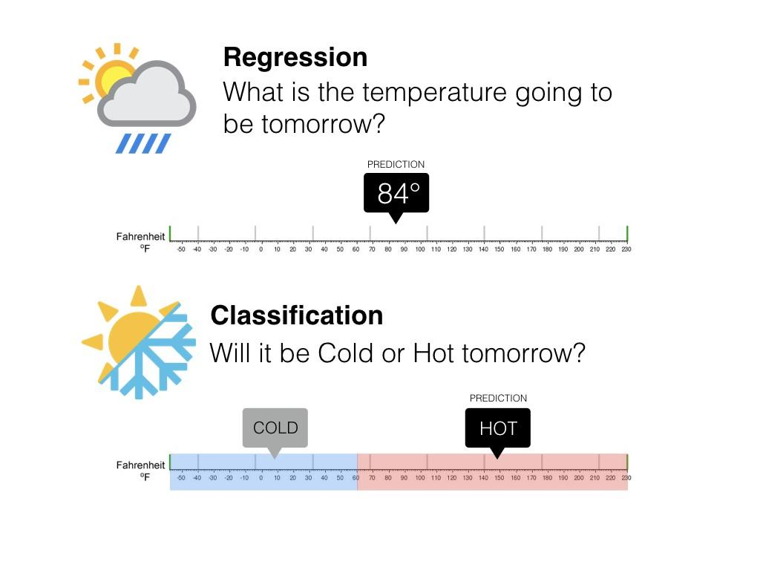
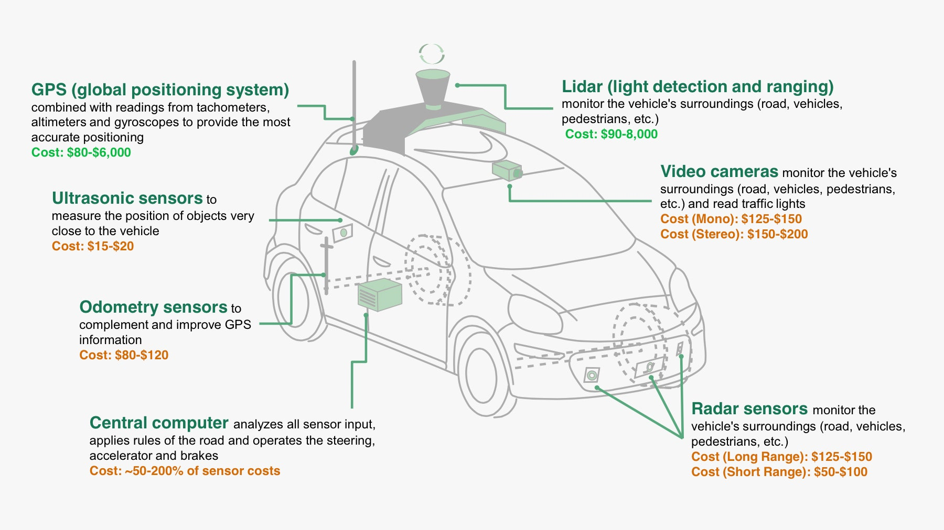
Input & Output
What exactly are you trying to model?
https://www.wired.com/2015/04/cost-of-sensors-autonomous-cars
https://medium.com/@ali_88273/regression-vs-classification-87c224350d69
Notes:
Do you want to know temperature or just if it is hot or cold.

Slide 26
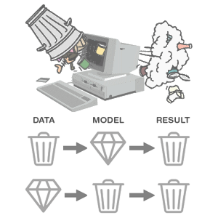
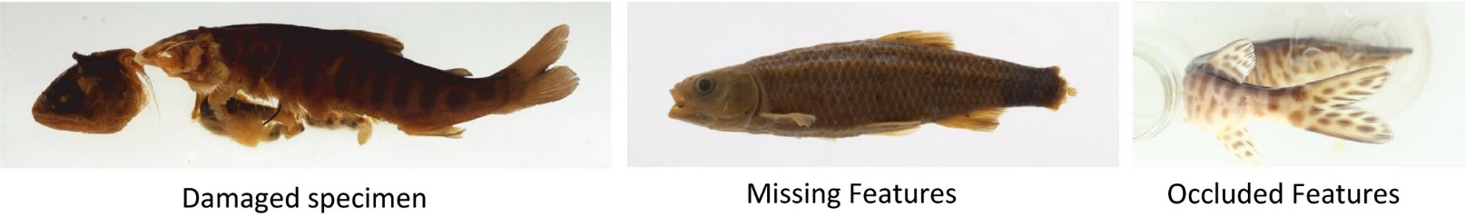
Data
Is there enough of it?
Does it need clean-up?
Elhamod, M., Diamond, K. M., Murat Maga, A., Bakis, Y., Bart, H. L., Mabee, P., Dahdul, W., Leipzig, J., Greenberg, J., Avants, B., & Karpatne, A. (2022). Hierarchy-guided neural network for species classification. Methods in Ecology and Evolution, 13, 642–652. https://doi.org/10.1111/2041-210X.13768
Notes:
Needs cleaning up. Is there enough of it.

Slide 27
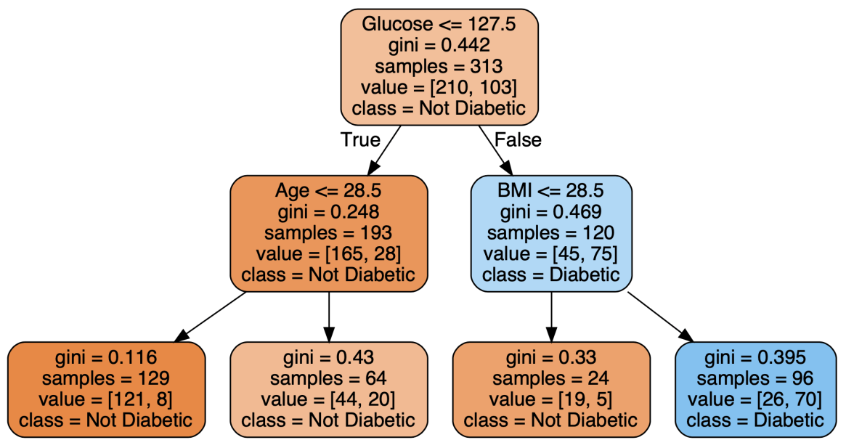

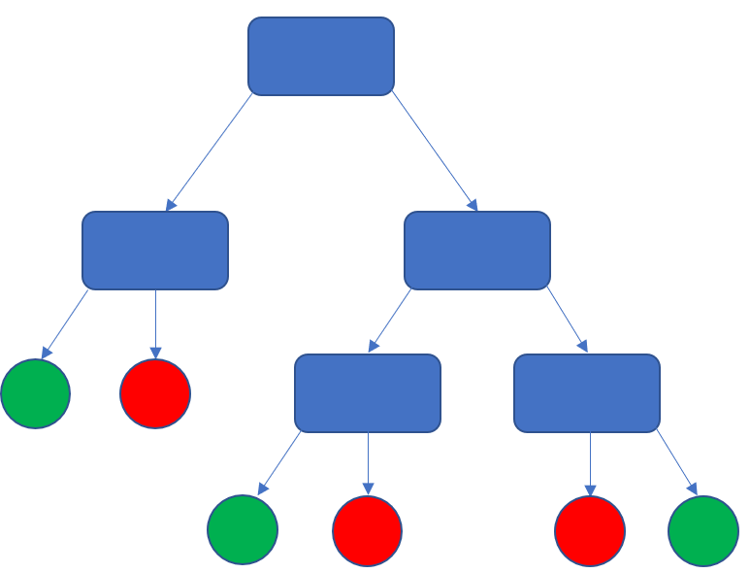
Model
What kind of model would be sufficient/suitable for modeling your data?
?
https://statisticallyrelevant.com/decision-trees-in-python-predicting-diabetes/
Notes:
Right model: decision tree for detecting a ball.

Slide 28

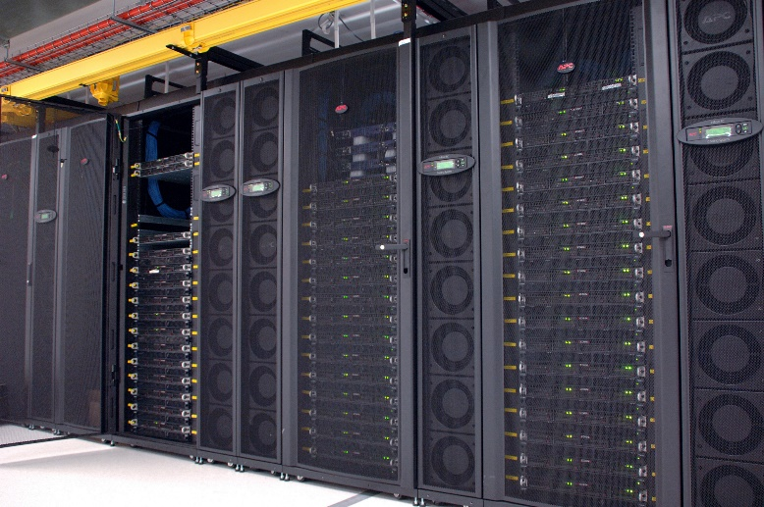
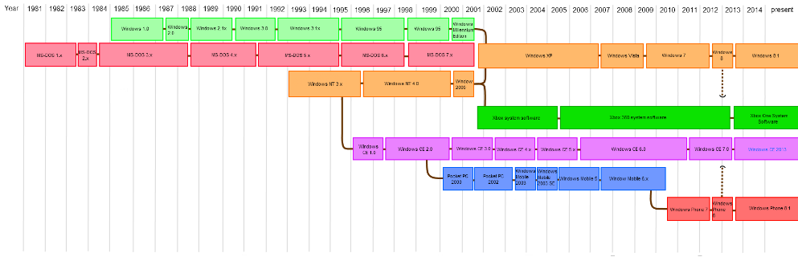
Resources
What compute resources are available?
What is the project’s timeline?
Notes:
Affects model choice

Slide 29
Demo
Notes:
Show how to get to SCC

Slide 30
Intro to ML
Continued…
Notes:
Everything Ill say here we can spent entire semesters on. So, don’t get overwhelmed. Just get the idea. Always ask questions.

Slide 31
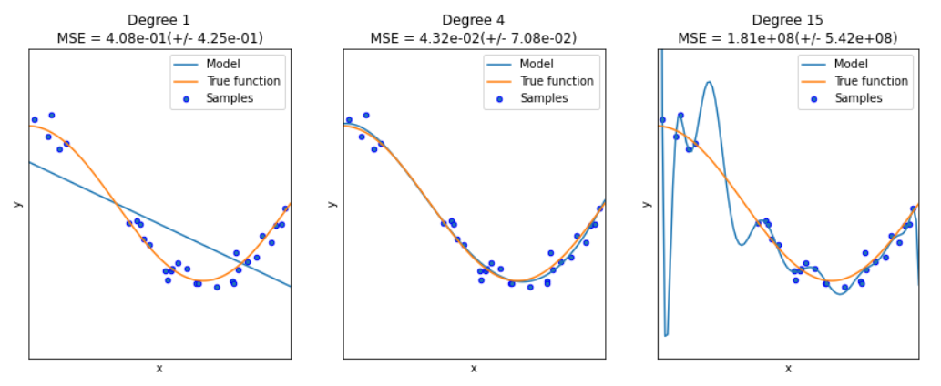
Model Generalization
Underfitting
Well-fitted
Overfitting
https://datascience.foundation/sciencewhitepaper/underfitting-and-overfitting-in-machine-learning
Notes:
Talk about model complexity as number of params

Slide 32
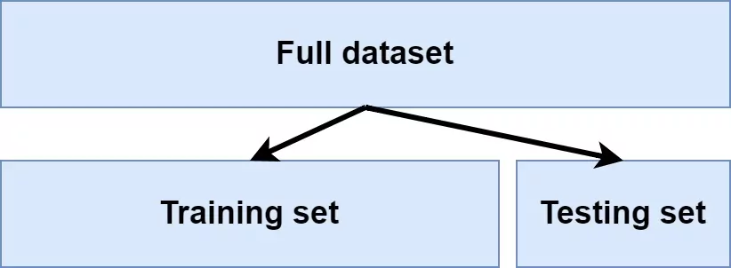
Model Generalization
https://www.machinecurve.com/index.php/2020/11/16/how-to-easily-create-a-train-test-split-for-your-machine-learning-model/
Notes:
Do you want to know temperature or just if it is hot or cold.
Needs cleaning up. Is there enough of it.
Right model: decision tree for detecting a ball.
GPUs… project deadline…

Slide 33
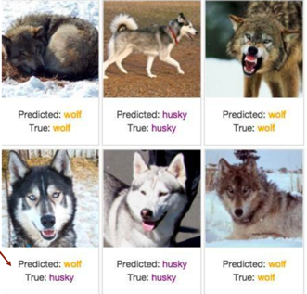
Model Generalization
https://medium.com/trusted-ai/explaining-ai-model-behaviour-with-ibm-watson-openscale-86515702c177
Notes:
Why is this important?

Slide 34
Neural Networks

Slide 35
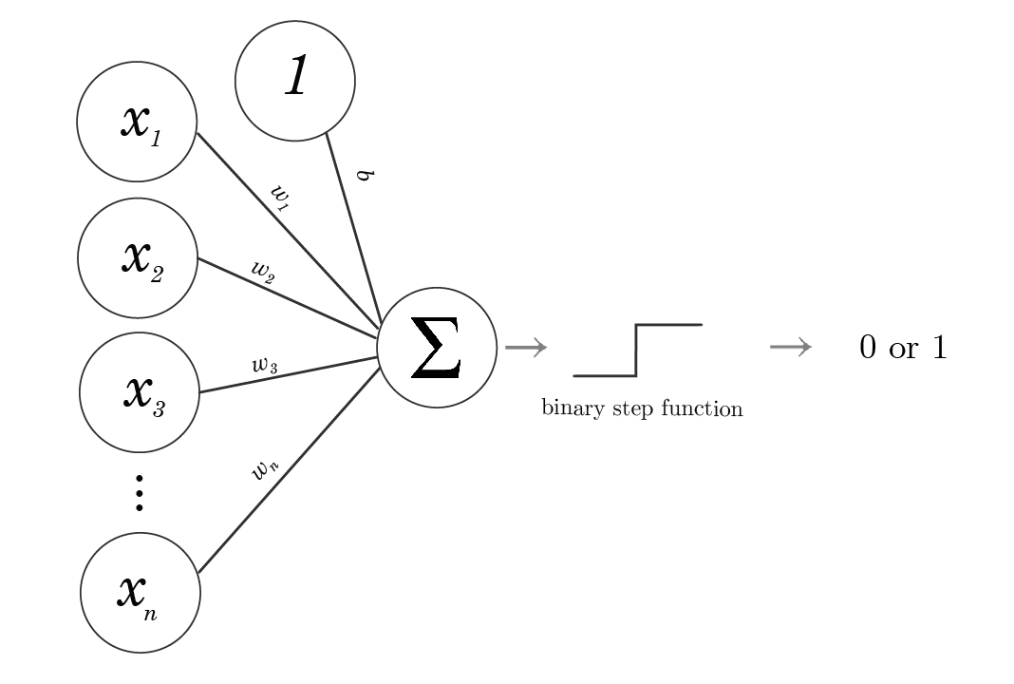
The building block: The Perceptron
Demo
Can we work around the “linear separability” issue”?
Adam Dhala
Notes:
Only works for linear separability
Mention ws = parameters = weights.
Example admissions based FPA and GMAT

Slide 36
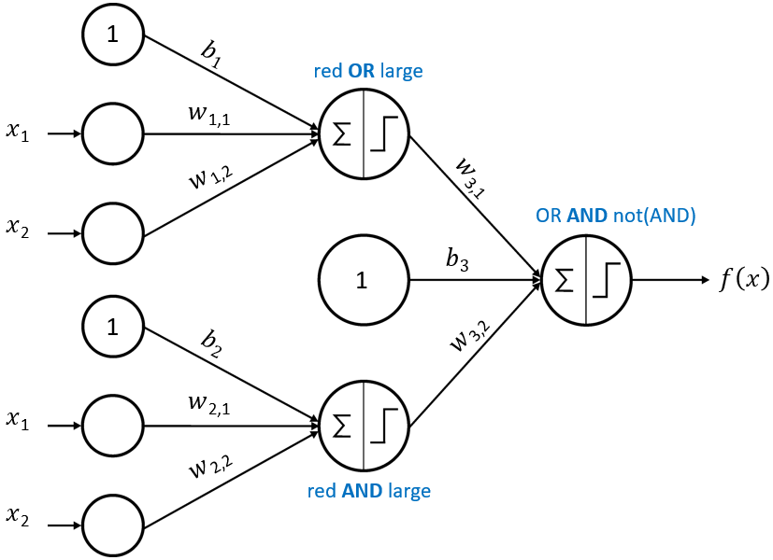
Power in Numbers: Multiple Perceptrons
Demo
western-neuralnets.ca

Slide 37
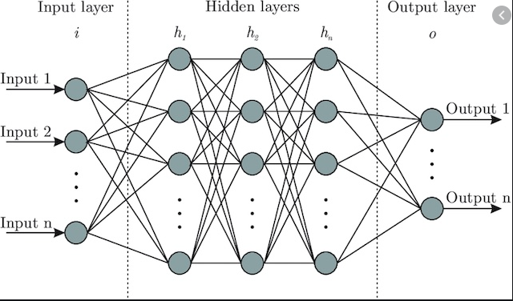

Neural Newtorks
Notes:
Only works for linear separability

Slide 38
Neural Newtorks
In theory, a single layer with an “infinite” number of neurons can approximate ANY function
In practice though…

Slide 39
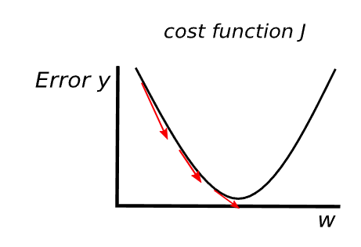
Optimization
The method that finds the best weights (i.e., weights that lead to lowest error).
Error ≡ loss ≡ cost function
Generally using gradient descent with backpropagation.
Elvira Siegel

Slide 40

Optimization
The method that finds the best weights (i.e., weights that lead to lowest error).
Error ≡ loss ≡ cost function
The method generally used is gradient descent with backpropagation.

Slide 41
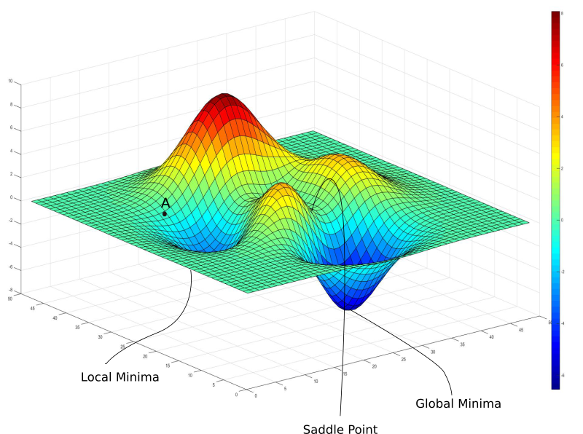
Optimization
Can we always achieve lowest error?
Demo
TechTalks
Notes:
Talk about lr effect and initialization effect.

Slide 42
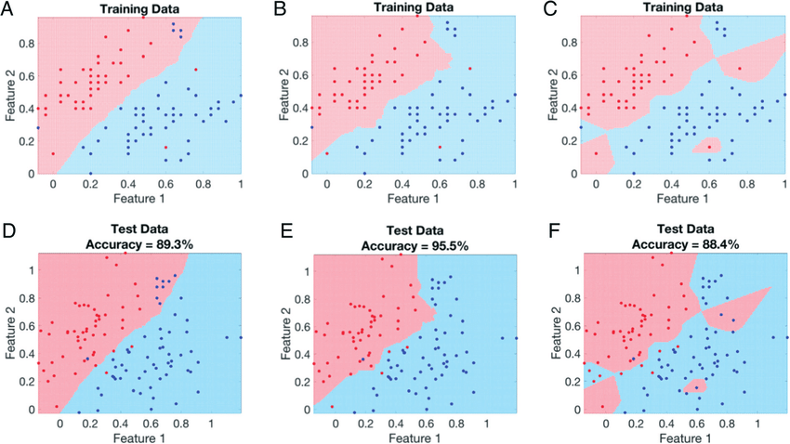
Overfitting and Underfitting
Better fit on the training data
underfitting
overfitting
Jina Ko
Notes:
Give some data and see why we never achieve 100% training (because data is confusing)

Slide 43
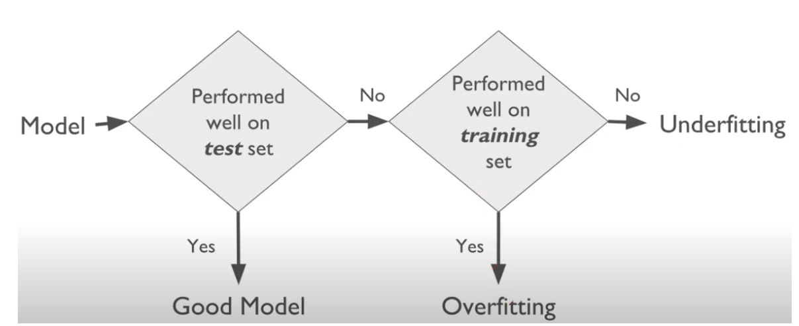
Overfitting and Underfitting
http://jcsites.juniata.edu/faculty/rhodes/ml/clusterAn.htm
Notes:
Give some data and see why we never achieve 100% training (because data is confusing)

Slide 44
Results are bad?
Check against a benchmark!
paperswithcode.com
kaggle.com
Are you overfitting or underfitting?
Notes:
Talk about lr effect and initialization effect.

Slide 45
How do I improve my results?
Best way: Get more GOOD data
If not, clean-up existing data.
Are you overfitting or underfitting?
Overfitting: get more data or use a less complex model.
Underfitting: get a more complex model.
Keep it simple!
Start with a simple model, simple data, simple code.
Test by component
Test by example
Notes:
Talk about lr effect and initialization effect.

Slide 46
Class Logistics

Slide 47
Survey Results
Office hours
Results
Notes:
Why I care about technical stuff
Why they didn’t fill it.
What projects are you interested in working on?
It will be more difficult in the beginning… because fundamentals are the most important part.

Slide 48
Pass through the Syllabus
Did you actually read it?

Slide 49
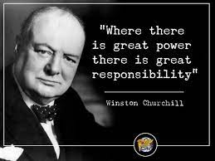
General Objectives
Assignments are meant to simulate challenges in real-life.
At the workplace, you can use the internet, code snippets, and even ChatGPT.
You can also discuss with others.
But you must cite your resources!
You cannot have someone do the work for you though.
No copy-paste of others’ solutions.
You must own your work!
Zero-tolerance for cheating.
Notes:
You might think I am going easy on you, but it is not as easy as you think… you will see.

Slide 50
Projects
You will form 6 groups, 4-5 students each.
You will pick a topic for your project such that it uses language models and targets a real-world application.
There should be some form of originality.
If in doubt or having trouble, talk to your professor.
Be creative and ambitious!
Notes:
I should figure out away to decide how to group them.
You will not be entirely graded on achieving tip-top results. The process is more important.

Slide 51
Projects
Your grade will depend on
A balanced workload among the team members.
The ability to present and document your problem, proposed solution, and results clearly.
The ability to achieve good (or promising) results, adequately justify any limitations, and propose solutions to those limitations.
Others’ ability to interact with your solution and their feedback.
The ability to iteratively improve your results over time according to plan.
Notes:
Add stuff to syllabus

Slide 52
Projects
Generally, all team members will get the same grade given they have contributed equally to the project.
Team members should also contribute, more or less, across the different component of the project (i.e., coding, writing, presenting, etc.)
Equal contribution:
For each submission, you will include a schedule of current and expected contributions per team member.
After the 1st milestone, you will fill a survey grading yourself and fellow teammates and reflecting on the health of your team. This is a chance to communicate any concerns you have regarding group dynamic or unfair work distribution.
If it becomes evident that some team members have significantly under-contributed to the project, they will be scored individually.
Notes:
add stuff to syllabus

Slide 53
Projects
The grade will be 15% project proposal, 35% 1st milestone, and 50% final milestone.
While the class will focus more on technology, you will get the chance to explore other aspects of project management.

Slide 54

Dicussions
Being able to communicate your thoughts and defend them is of utmost importance in the workplace.
Your active presence is also of utmost importance in the workplace.
You do not have to (and probably cannot) always be right. But, you will most certainly contribute to the learning experience.
Discussions can also take place on Blackboard.
They also include constructively critiquing other classmate’s projects.
Pre-class readings will be brought up in class and will count towards your grade.
https://livebook.manning.com/concept/machine-learning/ensemble-method
Notes:
You might think I am going easy on you, but it is not as easy as you think… you will see.

Slide 55
Individual Work
You will have 3-4 different individual assignments. You will be working on these on your own.
Some of these will be completely independent from the work in class, others will be a follow-up on a class demo.
Before reaching out to professor/TA with questions, make sure you have done your homework, given your best effort, and researched well on your own first.
Notes:
You might think I am going easy on you, but it is not as easy as you think… you will see.

Slide 56






Coding Frameworks and Platforms
Notes:
Talk about lr effect and initialization effect.

Slide 57


Shared Computing Cluster (SCC)
BU’s computing cluster with access to CPUs and GPUs.
Each of you will get a limited number of compute hours. Use your allocations wisely!
When facing issues, ask the professor or TA for help.
Don’t leave things till last minute!
Notes:
Talk about lr effect and initialization effect.

Slide 58
Assignment

Slide 59
Take a look at this other example
SCC Guide
Notes:
Fix it!

Slide 60
Homework
Finish the Jupyter notebook at home and submit the notebook on Blackboard.
Notes:
2nd best way… in assignment?

